Slide 1
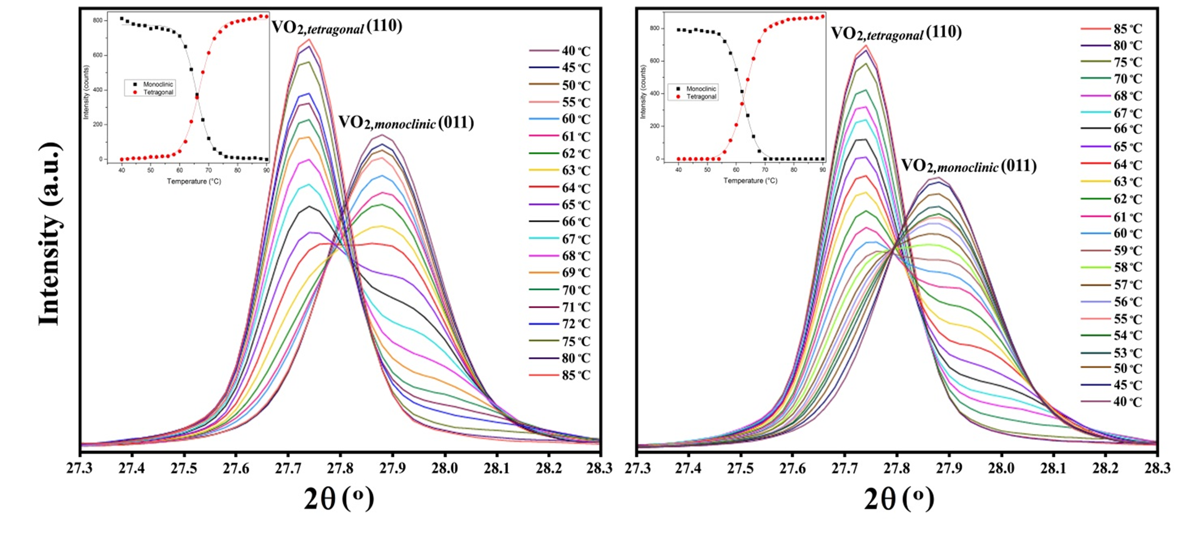
Jagdish (Jay) Narayan John Fan Family Distinguished Chair Professor North Carolina State University
Primary Research Interest:
Vanadium Oxide based Thin Film Heterostructures integrated with silicon and sapphire substrates
Primary Broader Impact Activity:
Work with Oak Ridge National Lab, NC A&T and Kopin Corporation
Interests in New Collaborations:
Novel defect characterization and property measurements and fabrication of new device structures
heating and (b) cooling cycles. The insets show the change of peak intensities as a function of temperature
Results of high temperature high resolution θ-2θ XRD performed on epitaxial VO₂ thin films grown on an NiO/MgO/TiN/Si(100) platform are depicted in Fig. 6. The results show that the (011) planes of monoclinic (M₁) VO₂ change to the (110) planes of tetragonal VO₂ across the SMT. The (110) and (011) intensities from tetragonal and monoclinic VO₂ crystals appear at 2θ angles of about 27.72º and 27.90º, respectively. These values are slightly higher than the 2θ values of bulk (relaxed) VO₂ showing that the crystals are under a compressive strain along their out-of-plane directions. Based on the established epitaxial relationship, [1$\overline{1}$0] orientation of tetragonal VO₂ is parallel to [001] orientation of NiO at the temperature of growth. Along the [1$\overline{1}$0] orientation of tetragonal VO₂, there are two sets of oxygen anions with an alternating distances of about 2.44 Å and 3.99 Å. These atoms couple with nickel cations, having a spacing of about 4.176 Å, along the [100] orientation of NiO. This results in a small tensile misfit strain of about 4.45%. Such a small strain is very hard to relax.

