Slide 1
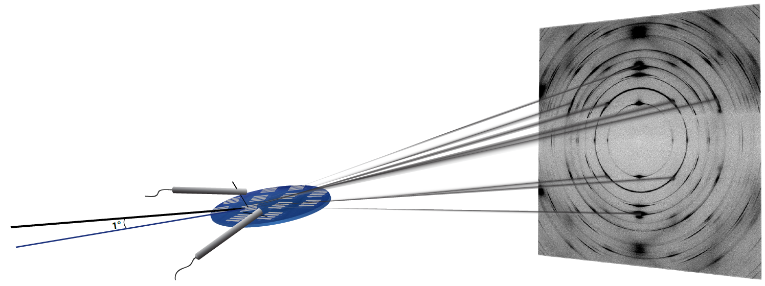
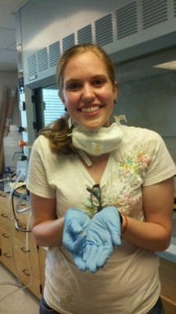
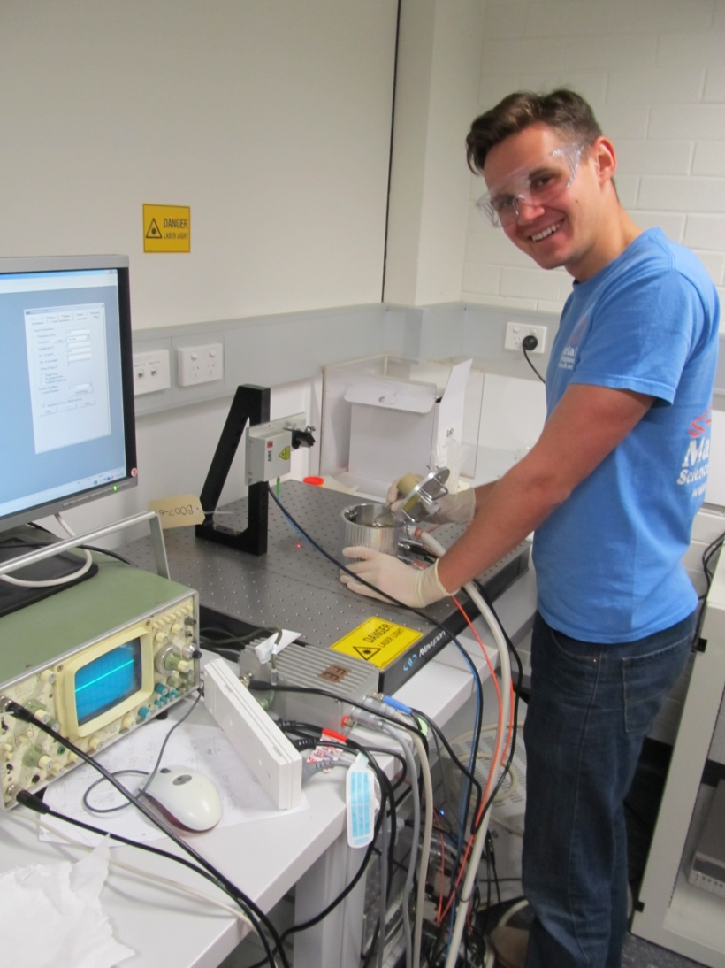
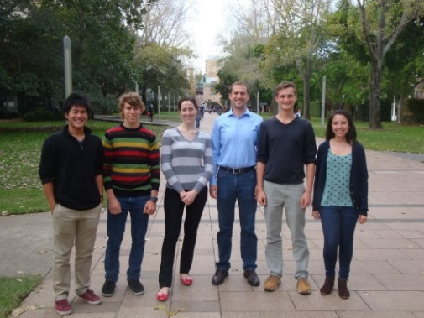
Jacob L. Jones Professor, Department of Materials Science and Engineering, North Carolina State University
Primary Research Interest: Developing structure-property-processing relationships in established and new materials, primarily through in situ X-ray and neutron scattering studies
Primary Broader Impact Activity: Undergraduate research experiences at home institution, national laboratories, and international sites
Interests in New Collaborations: Collaborators who have interesting challenges in understanding the synthesis and/or properties of perovskite and non-perovskite materials.
Contributions to research from Susan Sinnott, Jim LeBeau, and Susan Trolier-McKinstry

