Slide 1
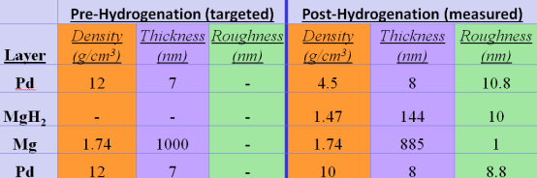
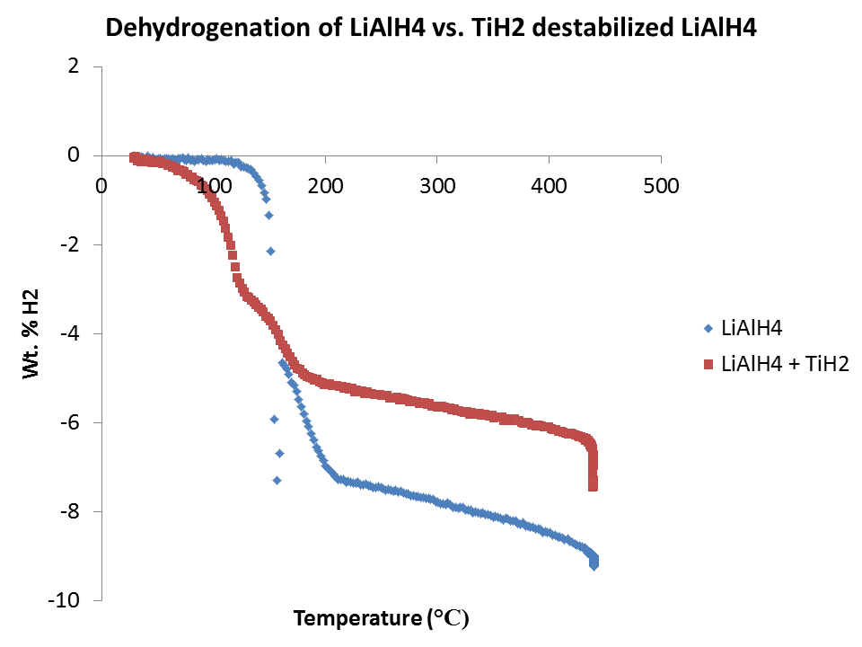
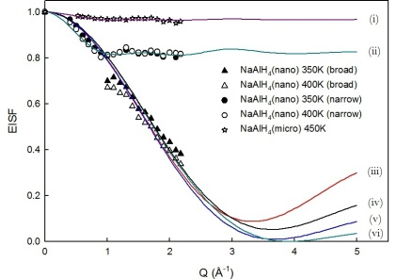
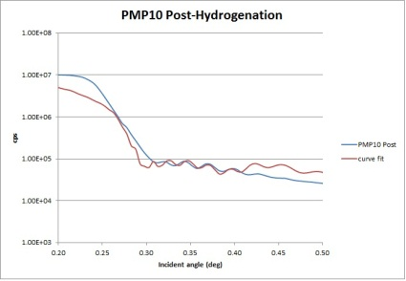
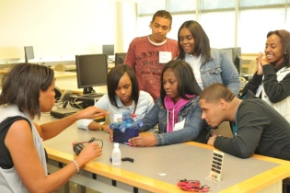
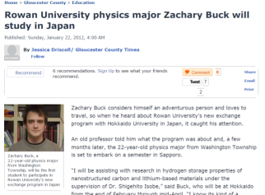
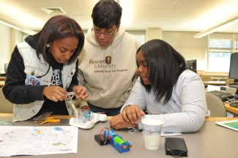
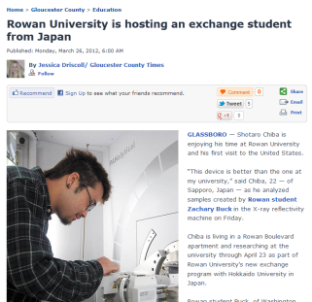
Enhancing Atomic Mobility and Desorption Kinetics in Light Metal Hydrides
Tabbetha Dobbins, Rowan University, DMR 1231153
Diffusion limitations in H
adsorption into Mg. Work of C. Steinmetz (Rowan, M.S. Student)
Solid State diffusion is enhanced in LiAlH₄ when mixed with TiH₂. Work of T. Smith (Rowan Univ., Undergraduate Student)
NaAlH₄ nanoconfined in Fe-BTC MOF shows significant long-range diffusion occurring at 77ºC. Work of S. NaraseGowda (LaTech Univ., Ph.D.Student)
Collaboration with S. Lofland (Rowan Univ.) and Andrew Goudy (Delaware State Univ.)
XRR shows 144nm ‘native’ MgH₂ layer forms via inward H₂ diffusion
Collaboration with C. Brown (NIST/NCNR) and T. Jenkins (NIST/NCNR)
Temperature Programmed Desorption (TPD) shows release of H₂ onset at 75ºC in LiAlH₄:TiH₂ (3:1 by mol) mixtures. Pure LiAlH₄ releases above T_{melt} at 170ºC (because convection necessary for ionic mobility).
QENS shows 20% of H in long-range (slower) dynamic motion at 77ºC & 127ºC. 70% of H undergo localized (fast) dynamics at these temperatures.
Collaboration with J. Hettinger (Rowan Univ.) and A. Goudy (Delaware State Univ.)
Project ENERGY
International Student
Exchange
Citations
Students from Camden County High Schools met on on Rowan’s campus for 6 Saturdays during the Fall of 2012 to learn about alternative energy and to help construct a website aimed at helping youth learn about sustainability and energy. (ProjectEnergy.net)
Collaboration with S. Isobe (Hokkaido Univ.)
Narase Gowda S., Ilavsky J., Gold S.A., Dobbins T., “Ultra Small Angle X-ray Scattering (USAXS) Studies of Morphological Changes in NaAlH₄”, Materials Challenges in Energy, Edited by Wicks G.G., et al., 224 pp 51-60 (2010).
2. Dobbins T., Ukpai W., “A Study of the Thermodynamic Destabilization of Sodium Aluminum Hydride (NaAlH₄) with Titanium Nitride (TiN) using X-ray Diffraction and Residual Gas Analysis”, Materials Challenges in Alternative and Renewable Energy: Ceramic Transactions Edited by Wicks G.G., et al. 224 pp 99-106 (2010).
3. Dobbins T., NaraseGowda S., Butler L, “Study of the Morphological Changes in MgH₂ Destablized LiBH₄ Systems Using Computed X-ray Microtomography”, Materials (Open Access), 5[10] pp 1740-51 (2012).
4. NaraseGowda, S., Brown C., Jenkins T., Dobbins T., “Quasi-Elastic Neutron Scattering Study of Hydrogen Dynamics in Nano-confined NaAlH₄”, PRB, in preparation.
5. Dobbins T., Smith T., Lofland S., “Solid State Transformations in LiAlH₄ destabilized with TiH₂”, J. Alloys and Compounds, in preparation.
6. Dobbins T., Steinmetz C., Hettinger J., “Formation of a Native Hydride Layer and Its Implication to Hydrogenation of MgH₂”, Int. J. Hyd. Energy, in preparation.
In the Spring semester of 2012, undergraduate students
Zachary Buck (Rowan U.)
and Shotaro
Chiba (Hokkaido U., Sappora,
JAPAN) each had
the opportunity to visit abroad
to perform
research.
Collaboration with W. Wigfall (Rowan Univ., C.H.A.M.P.) and K. Whitehead (Rowan Univ., Dual Enrollment)

