Slide 1
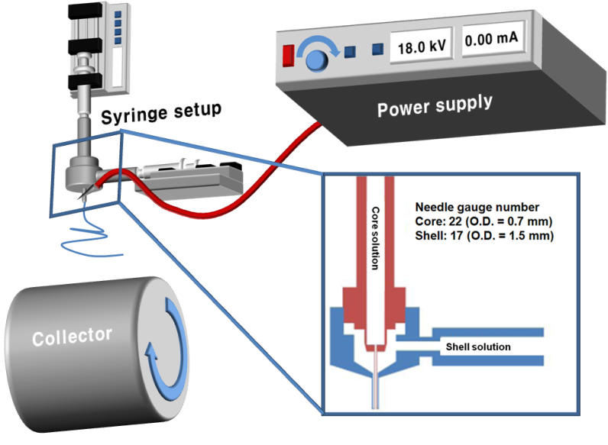
Sehee Lee Associate Professor, University of Colorado at Boulder
Primary Research Interest: Nanostructured Si-based materials, solid state batteries, & nanoscale interface engineering
Primary Broader Impact Activity: Science and technology of Li-ion batteries and other electrochemical technologies (new electrode materials)
Interests in New Collaborations: DFT simulation, solid state electrolyte, & characterization

