Slide 1
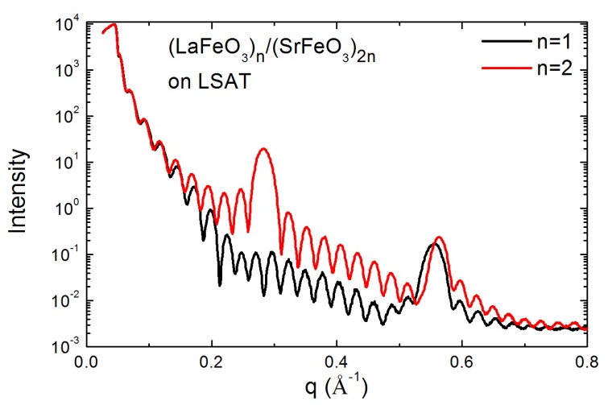
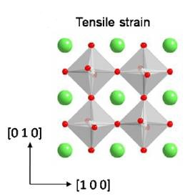
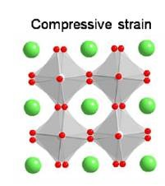
Steven J. May Assistant Professor, Drexel University
MBE-growth of complex oxide heterostructures; understanding local atomic structure in epitaxial perovskite films
Outreach to Philadelphia middle/high schools with significant populations of underrepresented minorities.
Interests in New Collaborations: topotactic reactions in oxide films, epitaxial nanostructures, surface science in complex oxides
Working to control octahedral behavior as a means to tune properties in oxides.

