Slide 1
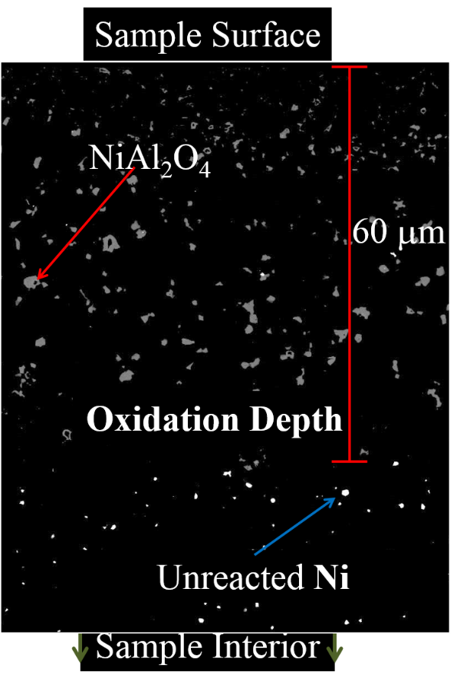
Martha Mecartney Professor, University of California, Irvine
Primary Research Interest: Oxide Ceramics for Energy Applications – how water vapor enhances diffusion.
Primary Broader Impact Activity: Mentoring - diversity high school students via Breakthrough Collaborative
Interests in New Collaborations: Characterization - (1) EELS or XPS to determine cation valence states in Ni/Al₂O₃, (2) techniques to map proton concentration profiles in oxides, (3) expertise in interpreting proton tunneling/hopping using D₂O
Diffusion depth (x) for oxidation of Ni to NiAl₂O₄ (in Al₂O₃ matrix).
1300°C results, exposed to water vapor, dry air, D₂O for various times.

