Slide 1
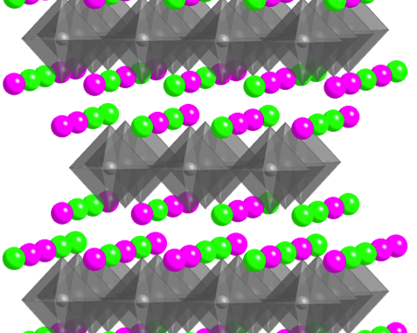
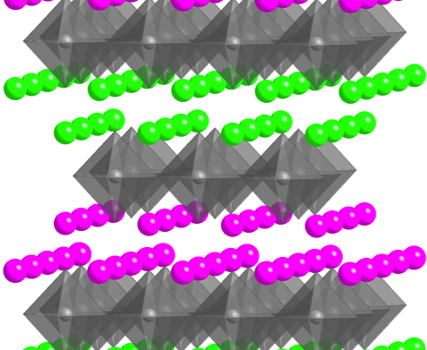
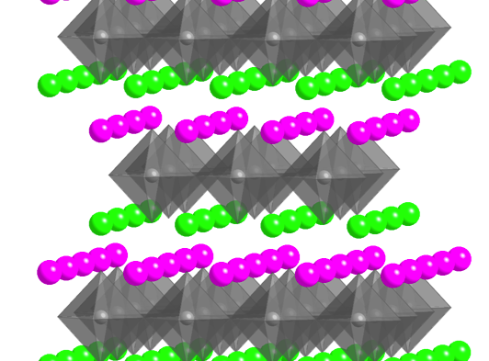
Brittany Nelson-Cheeseman Assistant Prof, University of St. Thomas, School of Engr
Effects of Cation Ordering on Structure and Transport (σ, κ, D) in Functional Oxide Thin Films
Mentoring Undergraduates
In-depth hands-on lab experiences (MBE growth & thin film characterization)
Women in STEM
Interests in New Collaborations:
Characterization: Thermal properties
Theory: Structure → Ionic conductivity
+
+
+
0
0
0
0
+
Create
Local Dipoles
Oxygens Move
to Screen Dipoles
Modifies Local Bonding and Structure
(Crystal Field, Rumpling, Interstitial Spaces, O_{ap} )
+ 5uc
+
0
+
+ 4uc
0
+ 3uc
+ 2uc
Film
+ 1uc
Subst.
- 1uc

