Slide 1
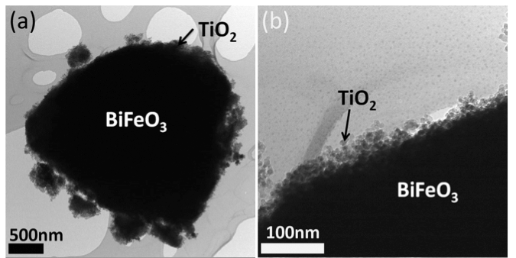
Paul A. Salvador Professor of Materials Science and Engineeering, Carnegie Mellon University
Primary Research Interests:
Design of Functional Materials
Thin Films and Complex Microstructures
Photocatalysis
Resistive Switching (Memristors)
Solid Oxide Fuel Cells
New Materials through Epitaxy
Primary Broader Impact Activity:
Graduate Education
Undergraduate Research
Undergraduate Laboratory Modules
Interests in New Collaborations:
High-throughput Property Measurements
Surface Property Measurements on Films
Schematic of high throughput mapping of films and substrates via electron back-scatter diffraction
TEM images of hierarchically structured photocatalysts

