Slide 1
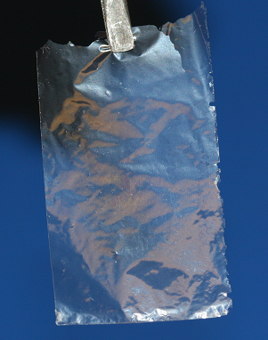
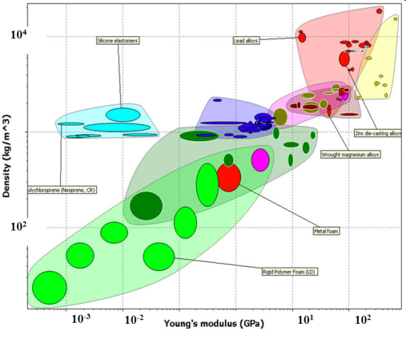
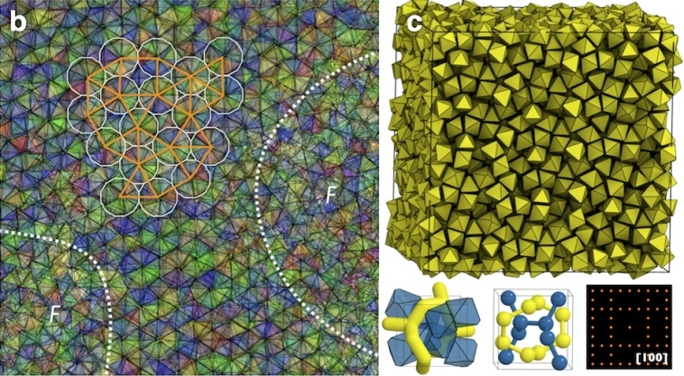
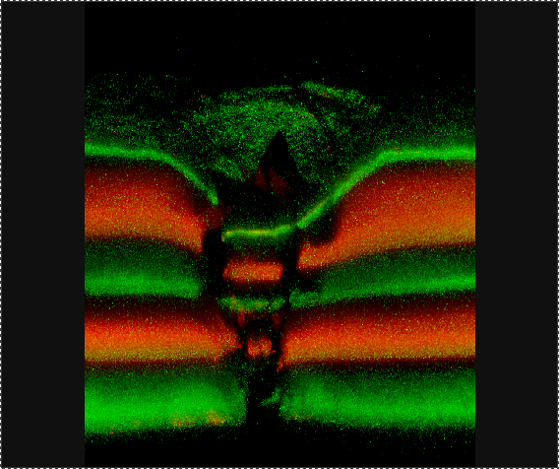
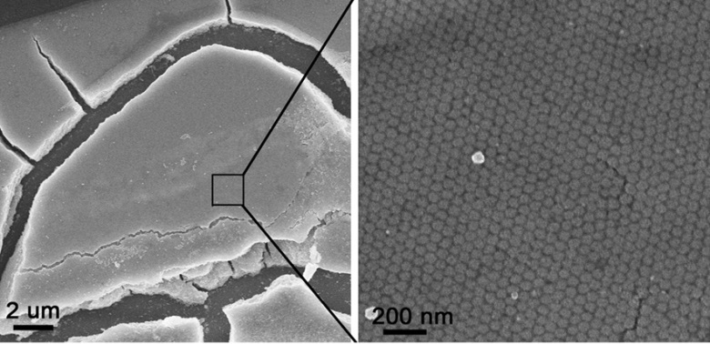
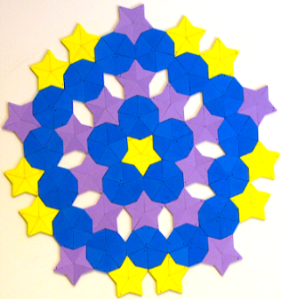
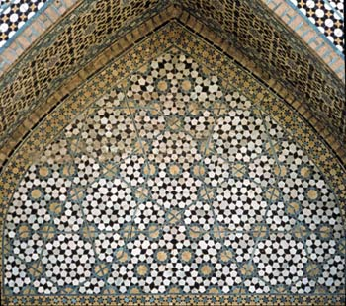
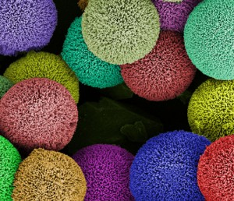
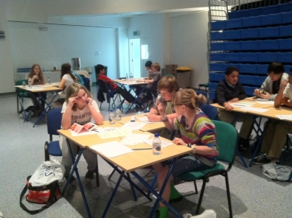
Nicholas A. Kotov Professor of Engineering, University of Michigan
Ashby plots
Primary Research Interest
Ceramic and composite materials
Self-assembly of ceramic particles
Quasicrystaline ceramics
Primary Broader Impact Activity:
Nexus of Science and Art
Math Olympics
Technology transfer
Interests in New Collaborations:
Nanomechanics
In-situ TEM techniques
Metal Foam
Substrate

