Slide 1
Holistic approach to mentoring (teaching and research) next-generation scientists & engineers
J. Narayan
Department of Materials Science and Engineering
Centennial Campus, EB I, Rm. 3030
North Carolina State University, Raleigh, NC 27695-7907, USA
E-Mail: J_NARAYAN@NCSU.EDU
2014 MRS Spring Meeting, April 20-25, San Francisco
NSF Workshop, June 16-19, 2014
Support: NSF (DMR, ECCS), ARO, DOE, NSF-NIRT, Kopin Corporation and Fan Family Foundation Endowment
Notes:
FFF2.01, April 22, 1:30-2:00PM, MW-2 (2012)

Slide 2
Key Challenges for Next Generation Materials Scientists
Agility
Versatility
3) Reduce the Transition Time
4) Enhance Productivity in View of Global Competition
5) Maintaining Edge in Research and Innovations

Slide 3
Octahedral Approach to Mentoring (Teaching & Research):
Transition from Science to Technology to Manufacturing (Society)
(Nano) Technology
(Nano) Science
Manufacturing
Devices and Systems
Synthesis and Processing: Ion Implantation, Laser Annealing and PLD
Atomic Scale Characterization: TEM/STEM-Z
Atomic Scale Modeling : Defects & Interfaces
Structure-Property Correlations
Base Support: Thermo & Kinetics Defects & Interfaces, Diffusion, and Phase Transformation
Manufacturing

Slide 4
Training and Mentoring of Students
Specialize in one of the critical components of the base, but some training in all of the four components, including the formation of test device structures
Research projects are designed in such a way that they need all the four base components and fabrication of test device structures.
Manufacturing aspects are addressed in collaboration with national labs & industry.

Slide 5
Examplesof Transition: (Nano) Science to (Nano) Technology to Society
Metal-Ceramic Nanocomposites (PRL – IR-100 Award)
a) Ductile and Tough Ceramics
b) Optical and Photothermal Applications
c) Nanomagnetics and Information Storage
d) Smart Magnetic Sensors on a Chip
2) High-efficiency Nanostructured LEDs
3) Integrated Sensors on a Chip

Slide 6
Critical Role of Materials
* Throughout human history, materials have defined our civilization. From Stone Age to Iron Age to Bronze Age to Semiconductors and now Nanomaterials, materials have played a critical role in improving the quality of human life and taking us to a next level.
For every advanced technology, there is a materials bottleneck which must be addressed and solved.
This is particularly critical in nanoscience and nanotechnology transition to manufacturing for the good of the society.

Slide 7
Changes in Curricula
New Courses with focus on: 1) synthesis and processing, 2) nanoscale characterization, 3) structure-property correlations, and 4) modeling and simulation
Basic courses with curricula to address small systems
Examples of Specific Courses:
Thin Film Science and Technology
Introduction to Nanostructured Materials
Ion-solid and Photon-solid Interactions: Ion Implantation and Laser Processing
Characterization across-the-scale and Structure-Property Correlations
Modeling of Defects and Interfaces

Slide 8
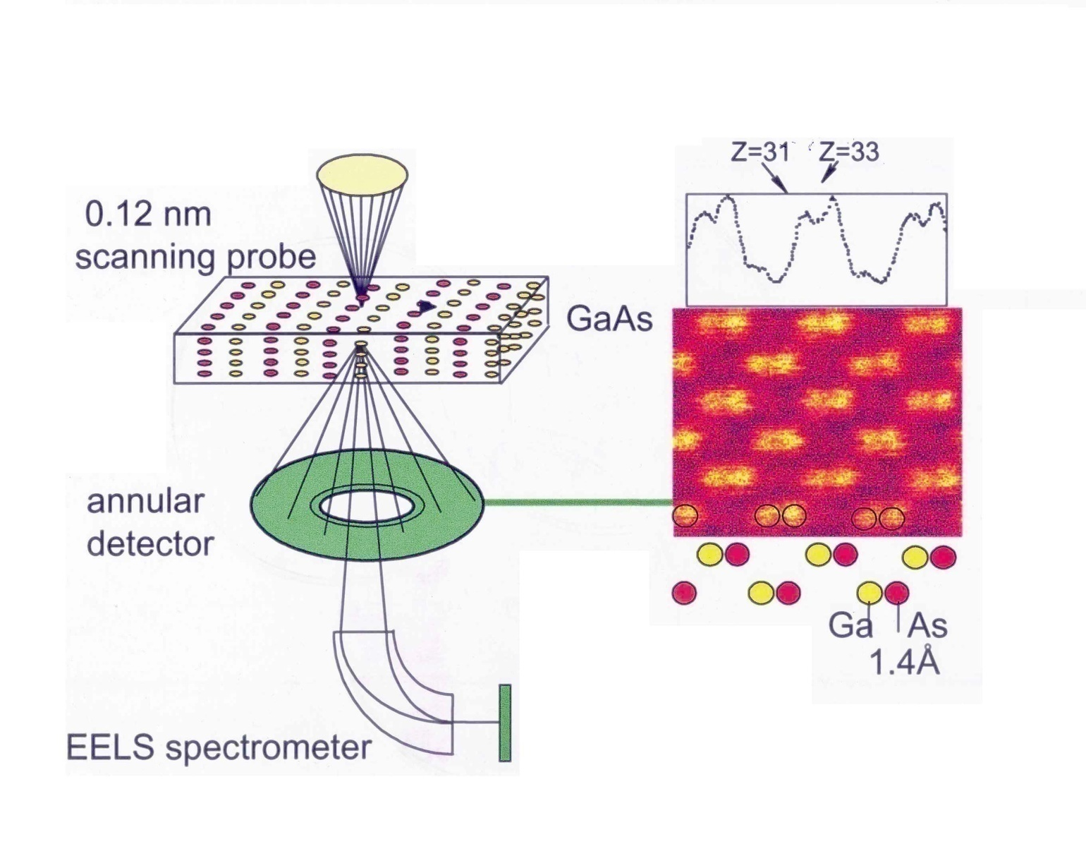
Z(Atomic Number)-Contrast Imaging in STEM
S. J. Pennycook and J. Narayan, Phys. Rev. Lett. 54, 1543 (1985); Appl. Phys. Lett. 81, 2728 (2002) & APL 97, 121914 (2010)

