Slide 1
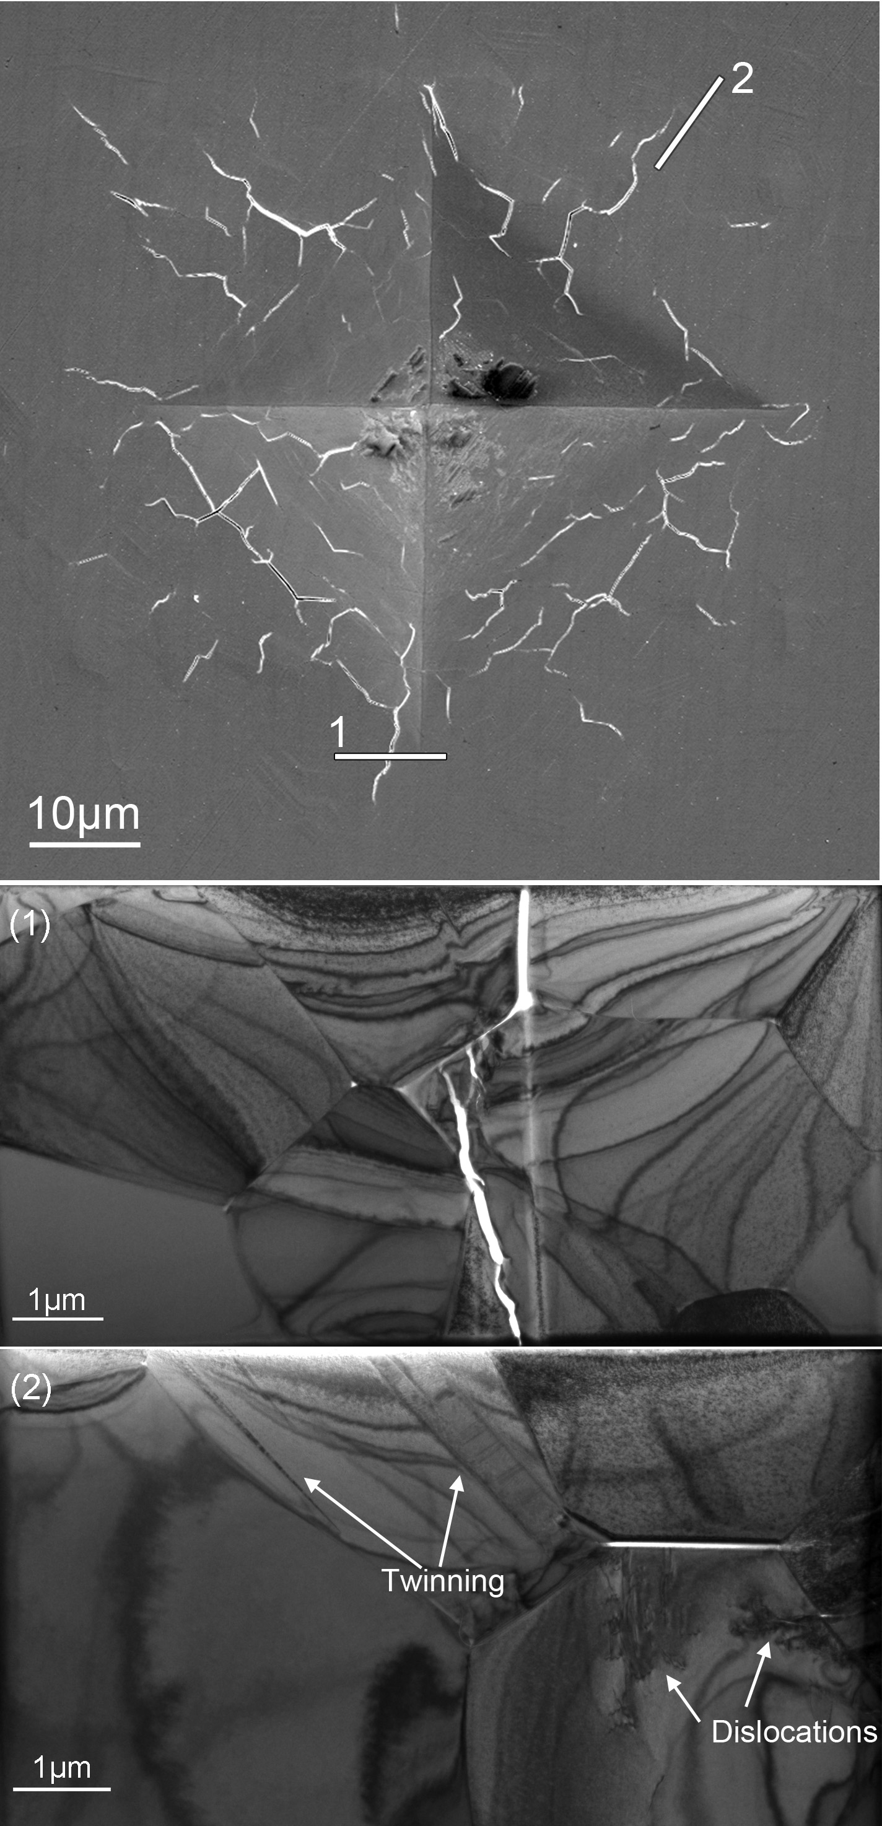
Jessica A. Krogstad Assistant Professor, University of Illinois Urbana-Champaign
Primary Research Interest: Influence of phase evolution on mechanical integrity of structural and functional ceramics
Primary Broader Impact Activity: Incoming coordinator of Girls Learning about Materials (GLAM) Summer Camp
Interests in New Collaborations: Looking for interesting ceramic systems with some ferroelastic contributions to domain formation or movement

