Slide 1
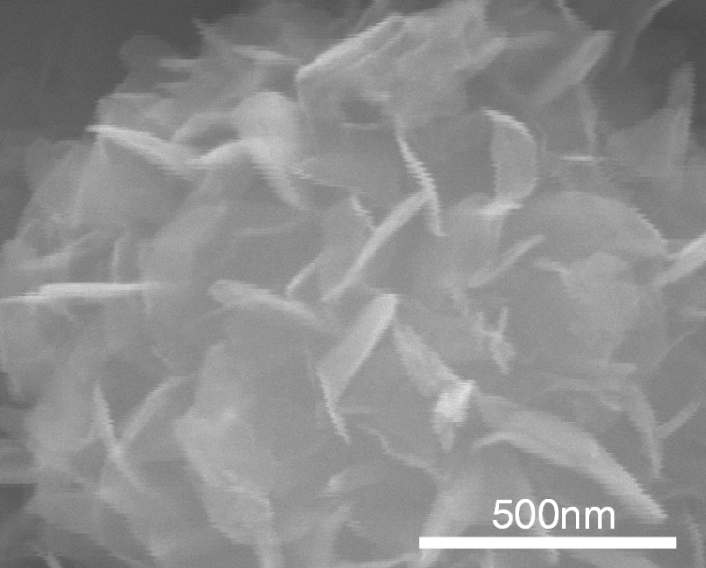
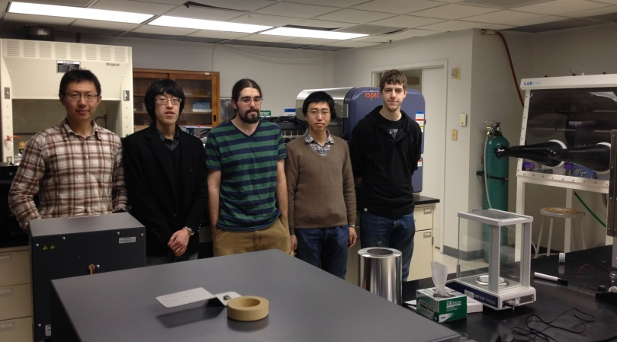
Dawei Liu Assistant Professor of Materials Science and Engineering, Inamori School of Engineering, Alfred University
Primary Research Interest:
Synthesis of nanostructured materials and investigation of their electrochemical energy storage and Catalytic properties
Primary Broader Impact Activity:
Involvement of female and minority undergraduate engineering students in research
Interests in New Collaborations:
Oxide surface modification by vapor or liquid phase reactions
Solution-derived TiO₂ nanostructure with
modified surface chemistry for enhanced
Electrochemical energy storage
http://people.alfred.edu/~liud/index.html

